Slide 1
Website for Tru Blue Tiling
Tru Blue Tiling is an Australian based pool tile company.
The website will be used to showcase work and provide a means to contact the company for quotes.
It will also provide information about the company & what services are offered.

Slide 2
Site Map
Home
Gallery
Services
Contact Us
About Us
Ceramic Options
Glass Options
Social Media Links

Slide 3

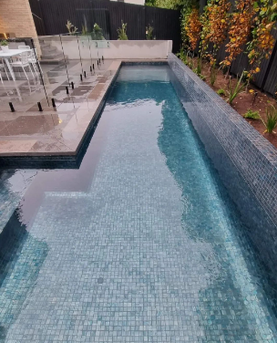
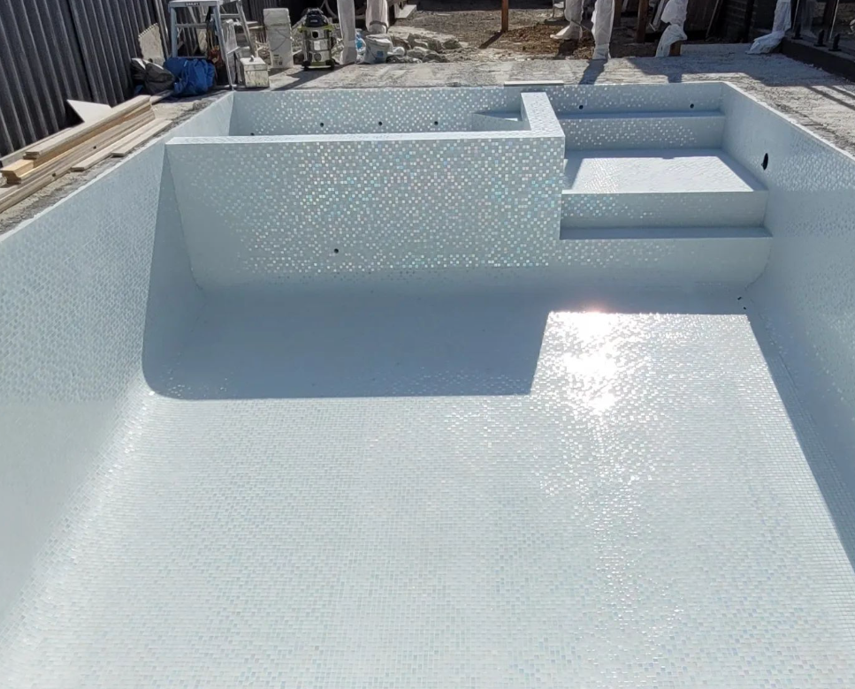
Tru Blue Tiling
Home
Pool Tiling & Renovation Experts
Home
Gallery
Services
Contact Us
About Us
Tru Blue Tiling specializes in transforming pools. From creating the perfect brand new pool for your backyard. To expertly renovating old style pools to bring them a second life.
With a focus on perfection and attention to detail. You won’t ever look back! Revitalizing your pool space to create your dream pool. Tru Blue Tiling offers a range of services from modernizing the aesthetics to enhancing the functionality of your pool, ensuring your pool becomes a timeless place of enjoyment and relaxation!
Glass, Mixed Gray Tile
Glass, White Pearl Tile

Slide 4
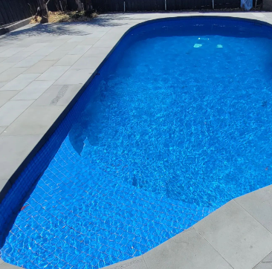
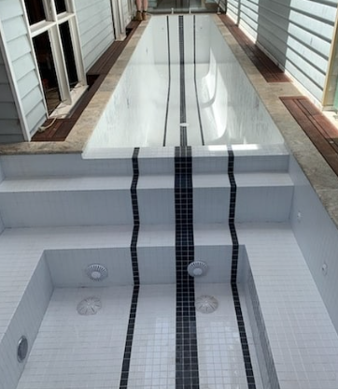
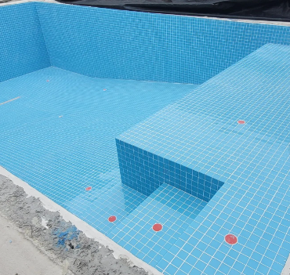
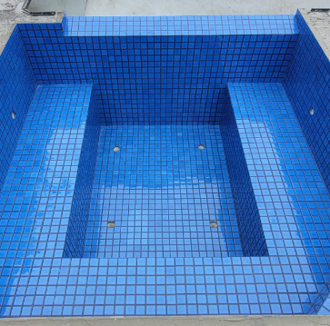
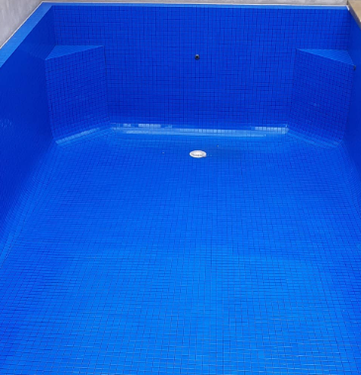
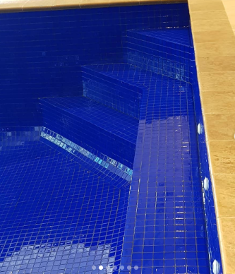
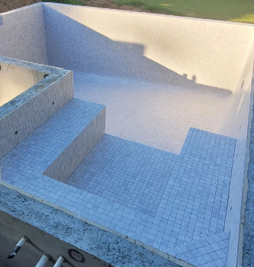
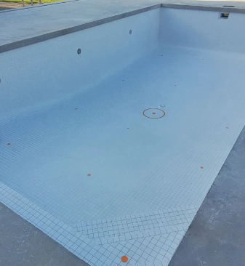
Tru Blue Tiling
Gallery
Pool Tiling & Renovation Experts
Home
Gallery
Services
Contact Us
About Us
Glass Range
Ceramic Range
Tru Blue Tiling offers customers a choice of glass and ceramics tiles for their pool interiors. With a vast selection of colors and styles available. You can personalize your pool to match your taste.
Whether it’s sleek glass or classic ceramic, we ensure that every pool reflects the customers style.

Slide 5
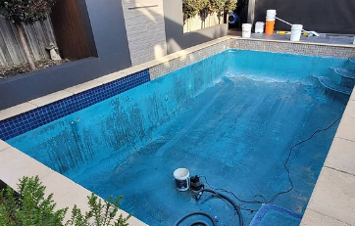
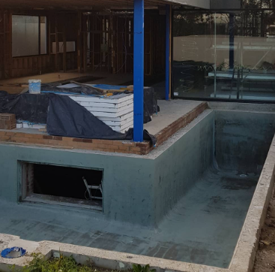
Tru Blue Tiling
Services
Pool Tiling & Renovation Experts
Home
Gallery
Services
Contact Us
About Us
Tru Blue Tiling specializes in pool renovation, bringing older pools back to life. Additionally we also work with new swimming pools.
Starting from the concrete shell all the way to filling it up. Tru Blue Tiling is committed to creating the best possible outcome for either your renovation or new construction.
Pool Renovations:
Bringing your older pools back to life by improving the aesthetics and restoring functionality. From repairing worn out surfaces to total pool upgrades. Tru Blue Tiling offers a wide range of renovation options.
About us
New Pools:
Tru Blue Tiling offers custom designs and expert installations aimed to satisfy any clients preference. Focusing on quality and attention to detail, we ensure that every new pool is durable, functional and most of all; a centerpiece for your backyard.

Slide 6
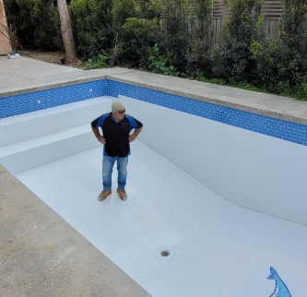
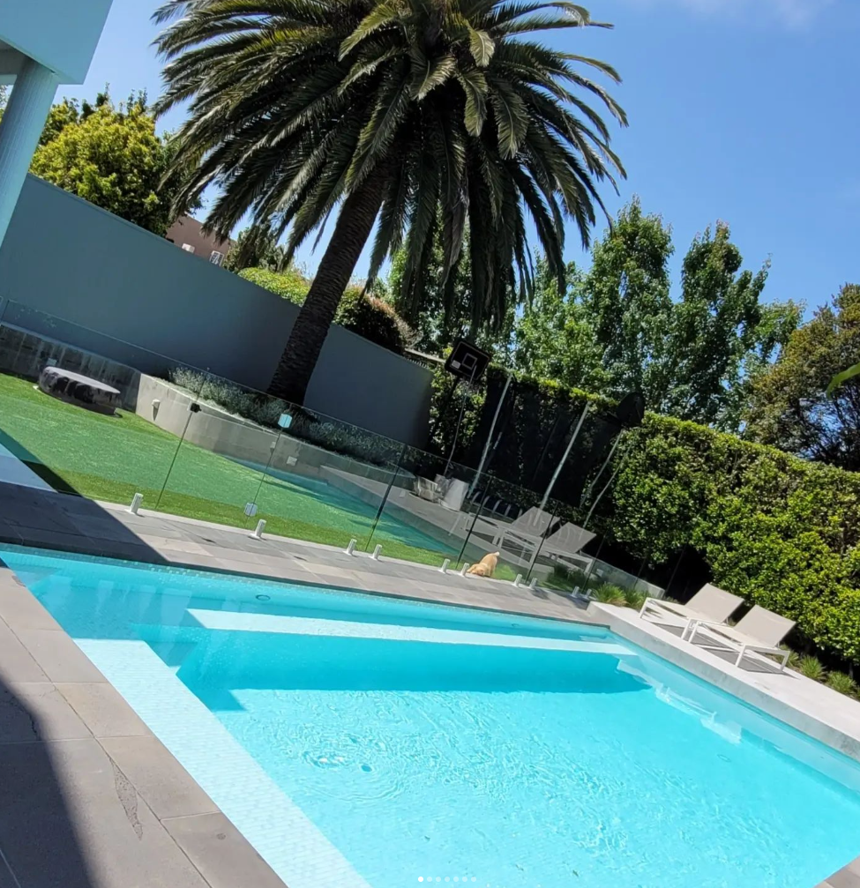


Tru Blue Tiling
Contact Us
Pool Tiling & Renovation Experts
Home
Gallery
Services
Contact Us
About Us
Contact Us:
You can connect with the team via email or through mobile.
Email: Email@Gmail.com
Mobile: 0000-000-000
Or you can reach out on our social media platforms and get in contact with Jason to find out more.
Contact us
@trubluetiling
trubluetiling

Slide 7
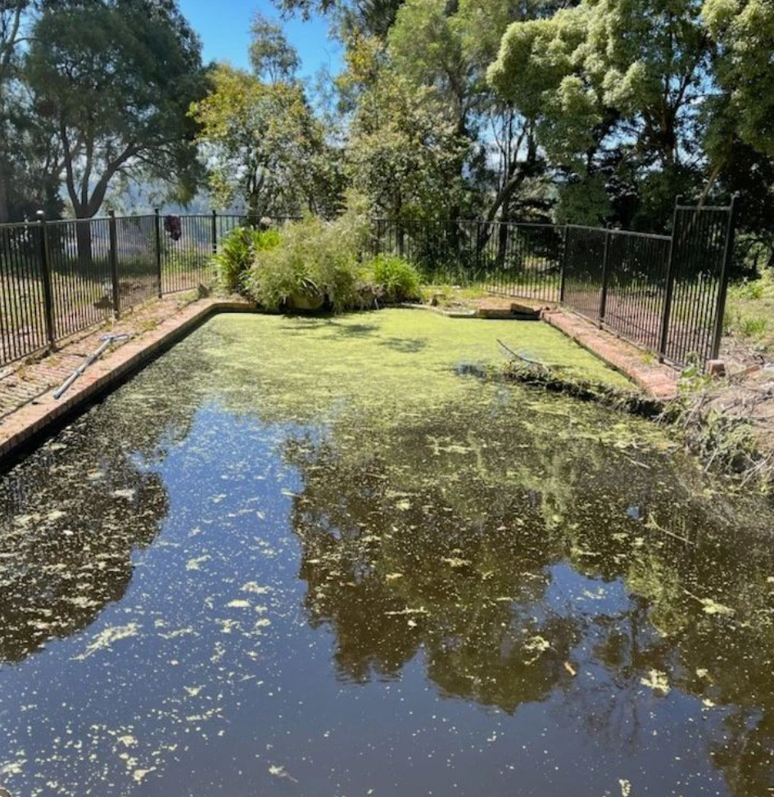
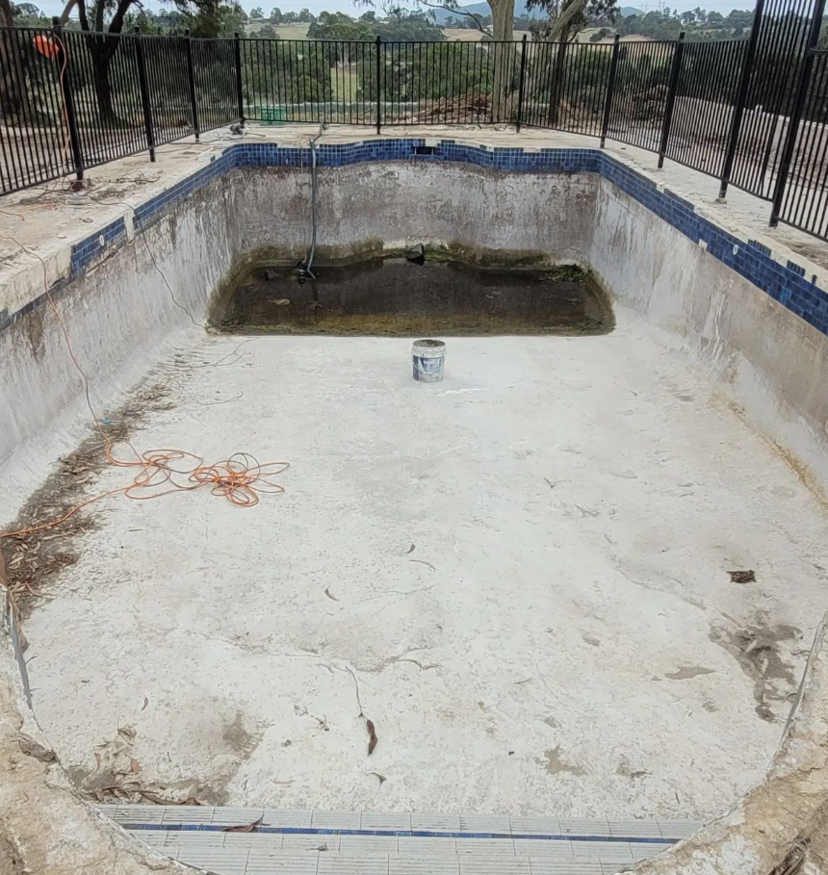
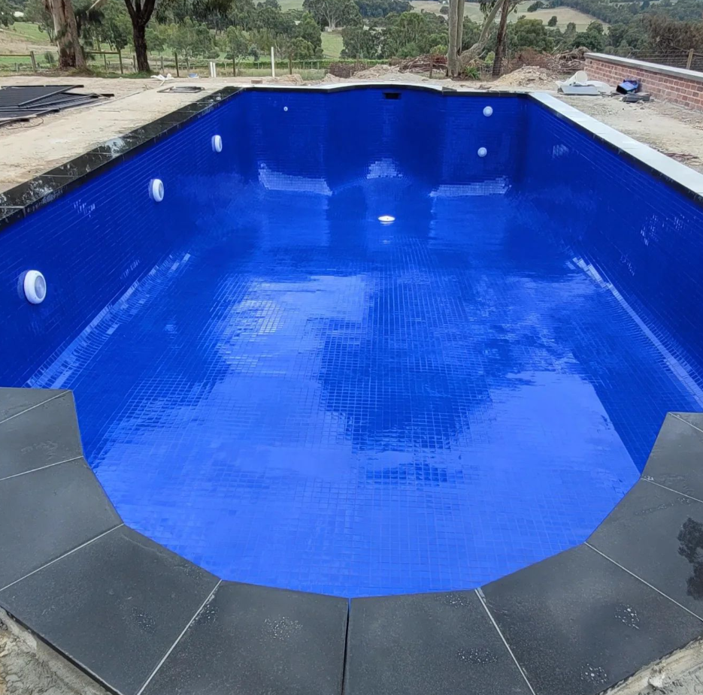
Tru Blue Tiling
About Us
Pool Tiling & Renovation Experts
Home
Gallery
Services
Contact Us
About Us
Tru Blue Tiling is a locally owned and operated family business.
Tru Blue Tiling has been building and renovating pools for over 30 years.
From new builds to renovations, Tru Blue Tiling has established itself as one of the top tiling businesses in Melbourne.
Get a Quote

